Slide 1
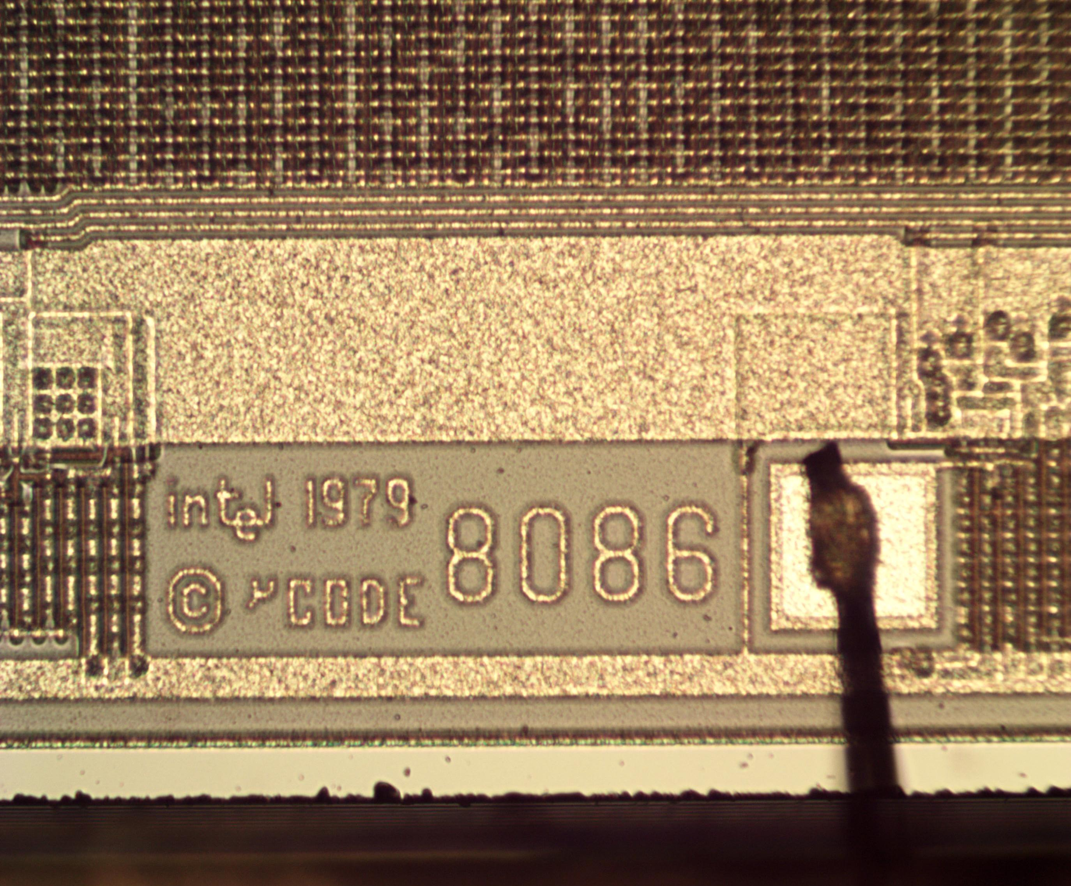
Presented By :
Md. Moshiur Rahman
221902324
Section : 222_D6
Course Code : CSE _304
8086 - Memory & I/O interfacing
Submitted To :
Md. Jahid Tanvir
Lecturer,
Department of CSE ,GUB.

Slide 2




Outline
Chapter
Chapter
Chapter
Chapter
1
2
3
4
Introduction
Implementation
Performance Eva,
Conclusion
Overview
Design Goals / Objective
Application
Project Details
Workflow
Program Code
Simulation
Results Analysis
Discussion
Limitations
Scope of Future Work

Slide 3

Introduction
Application
Design Goals
Overview

Slide 4

Overview + Architect. design
The bookstore application offers browsing and buying books in different categories with prices. User-friendly and efficient inventory management.
Application
Design Goals
Overview

Slide 5
Design Goals / Objective
This assembly language project based bookstore app prioritizes user-friendliness and simplicity, ensuring easy book selection and purchase.
Application
Overview
Design Goals

Slide 6
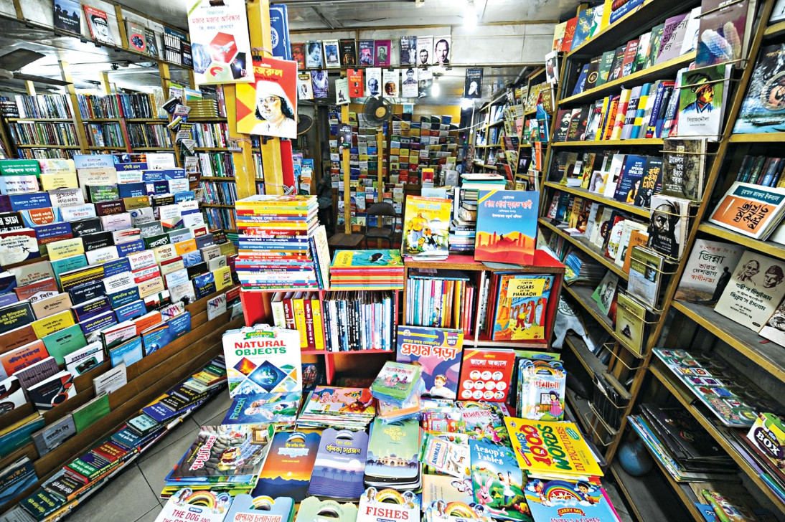

Application
This assembly language project bookstore app offers a user-friendly interface with seamless navigation. Users can easily select books, specify quantities, and enjoy a convenient purchasing experience.
Application
Design Goals
Overview

Slide 7
Implementation
Source Code
Workflow
Details

Slide 8
Project Details
The assembly language book store project, developed by Moshiur & Turtle with help of Dulal & Shajid, showcases effective inventory management and seamless book-related transactions, serving as a practical tool for real-world scenarios.
Source Code
Workflow
Details

Slide 9
The Workflow
The assembly language book store application follows a structured workflow, allowing users to browse and purchase books easily.
Source Code
Details
Workflow

Slide 10
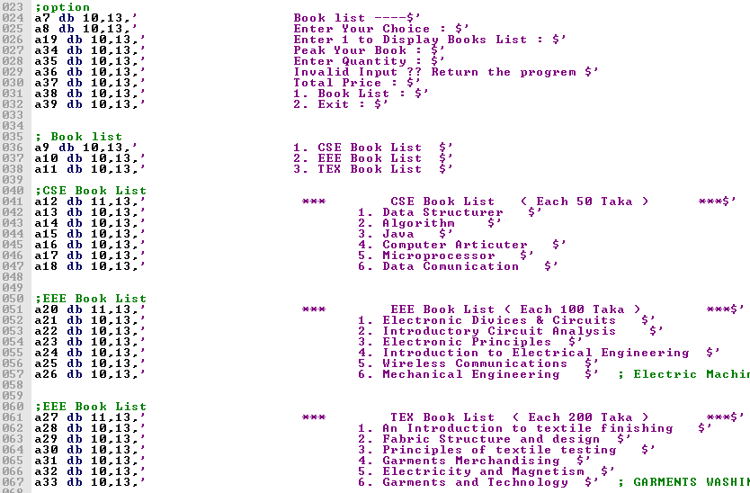
Source Code
Workflow
Details

Slide 11
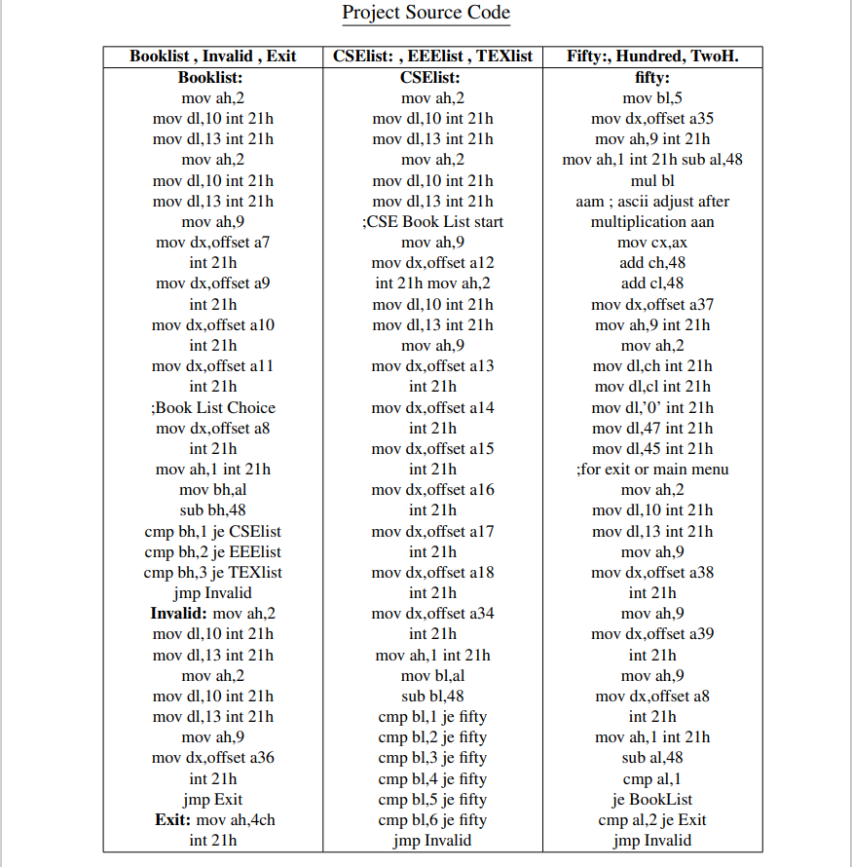
Source Code
Workflow
Details

Slide 12


Performance Evaluation
Simulation
Results

Slide 13


Simulation Environment / Procedure
Results
To simulate the outcomes of our project, me and my pc (turtle) have set up different experimental setups based on my PC configurations. In this section, we will discuss the specific requirements and environment installation needed for each simulation.
Simulation

Slide 14
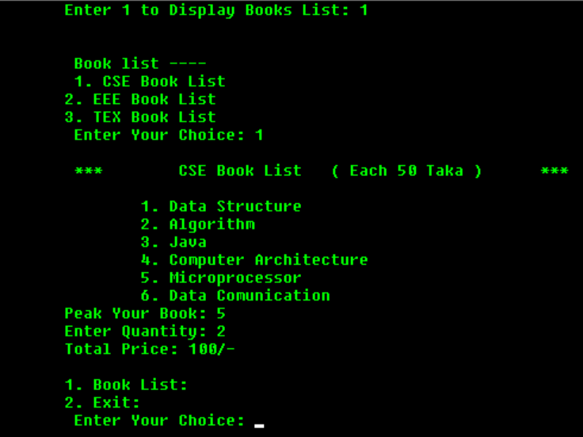

Results Analysis and Testing
Simulation
Types of Decoding
Results
Figure 3.1: CSE Book List Output.

Slide 15
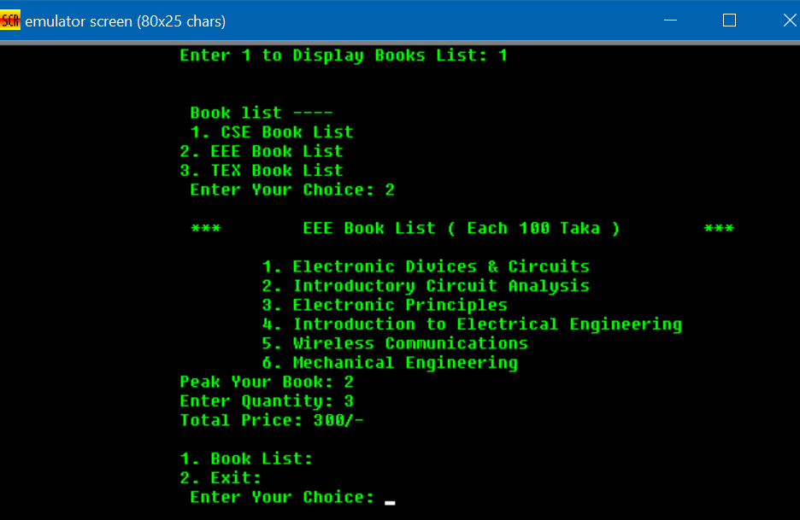
Results Analysis and Testing
Simulation
Types of Decoding
Results
Figure 3.2: EEE Book List Output.

Slide 16
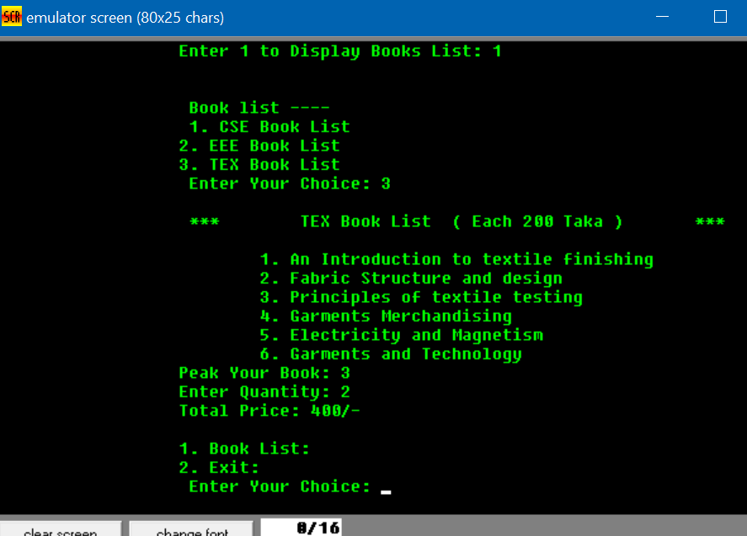
Results Analysis and Testing
Simulation
Types of Decoding
Results
Figure 3.3: TEX Book List Output.

Slide 17
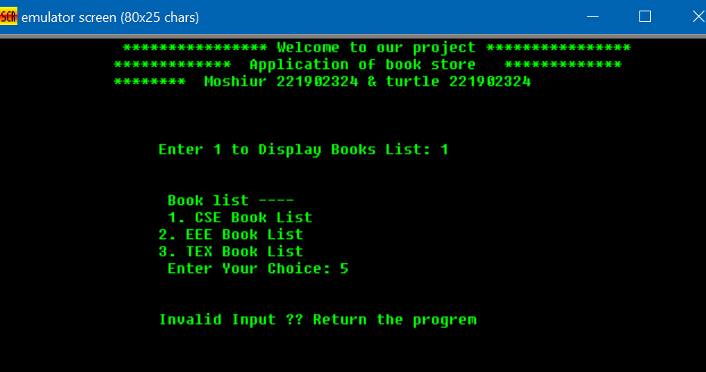
Results Analysis and Testing
Simulation
Types of Decoding
Results
Figure 3.4: Invalid Input Output.

Slide 18
Conclusion
Future Work
Limitations
Discussion

Slide 19
Discussion
The assembly language project for a book store application has successfully demonstrated a user-friendly interface and accurate pricing calculations. Future enhancements can further enrich the application.
Future Work
Limitations
Discussion

Slide 20
Limitations
The book store application in assembly language has limitations in terms of advanced features, user interface, error handling, scalability, and extensibility. Addressing these would improve its robustness and functionality.
Future Work
Discussion
Limitations

Slide 21
Scope of Future Work
This Project includes user authentication, real-time inventory updates, secure transactions, improved user interface, expanded book categories, and continuous updates for longevity and relevance.
Future Work
Limitations
Discussion

Slide 22
References
https://www.thedailystar.net/my-dhaka/news/library-lane-the-forgotten-bookshops-new-market-3653186#lg=1&slide=0
https://www.tutorialspoint.com/assembly_programming/assembly_arithmetic_instructions.htm
Future Work
Limitations
Discussion

Slide 23
Thank You
Keep Learning, Keep Grinding

